Slide 1

San Francisco Crime Classification (Kaggle - Competition)
INFO 7390 : Advances in Data Sciences/Architecture
Team 7
Chandni Sharma
Hari Panjwani
Sanath Shetty

Slide 2
Problem Statement
San Francisco is the cultural, commercial and financial center of Northern California
Known for its tech scene but it has a massive criminal past
Effect of sudden growth of population on the local crime scene

Slide 3
Objective
Focusing on accurately predicting the type of crime based on 12 yrs of records
Analyze trends and suggest measures to keep the city safe
Extending the model to other cities

Slide 4
Tools & Technologies
ML Algorithms:
Multi-Class Decision Forest
Multi-Class Decision Jungle
Multi-Class Neural Network
Technologies:
Frontend: - Bootstrap, CSS, JavaScript, JQuery
Java Programming Language
Tomcat 8 Server
Spring MVC Framework, Maven
AWS Services
Tools:
Microsoft Azure Machine Learning Studio
STS IDE / Eclipse IDE
R Studio
Power BI

Slide 5
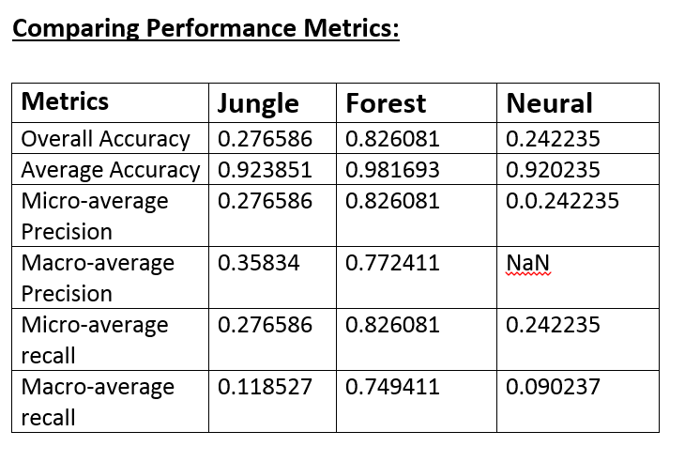
Model Selection

Slide 6
Business Case
Analysis will help to get an overall view on category of crime w.r.t. district
Patrolling/ Checks could be conducted in notorious areas to curb criminal activities

Slide 7

Any Questions?

